Slide 2
Introduction to Programming PROG101

Slide 3
Week 12 The Pandas Library for Data Analysis

Slide 4
Outlines
Utilize the Pandas Library for Data Analysis.
Apply python techniques to filter rows of a pandas DataFrame by conditions
Apply python techniques to sort and group a Pandas Data Frame.

Slide 5
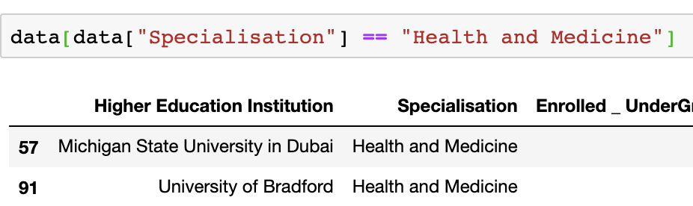
Slice data using simple conditions
You can also slice data using conditions based on the value of one or more columns.
The structure of the command line is:
DataFrame[Condition]
Example 1
Display all the rows where "Specialisation" is "Health and Medicine"
Condition
data["Specialisation"] == "Health and Medicine"

Slide 6
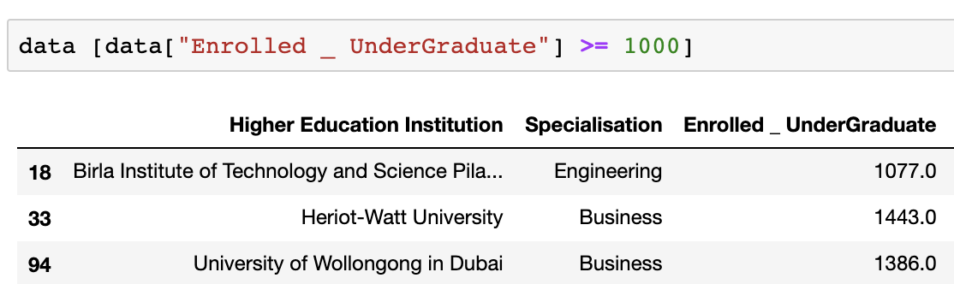
Slice data using simple conditions
Example 2
Display all the rows where " Enrolled _ UnderGraduate" is 1000 and above
Condition
data["Enrolled _ UnderGraduate"] >= 1000
Example 3
Display total number of rows where "Enrolled _ UnderGraduate" is above
the average "Enrolled _ UnderGraduate"
Condition
data["Enrolled _ UnderGraduate"] >= data["Enrolled _ UnderGraduate"].mean()

Slide 7
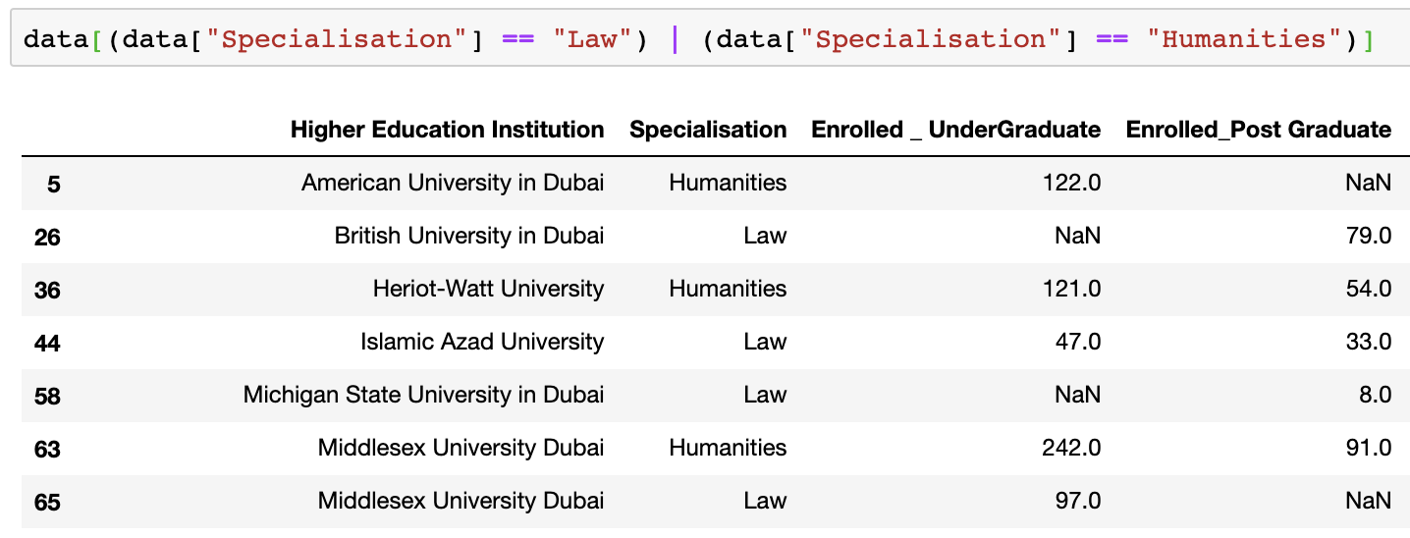
Slice data using multiple conditions
To slice data using more than one condition, you need to put each condition inside a bracket ( ).
You also need to use a logical operator. The symbol & is used for and. The symbol | is used for or.
The structure of the command line is:
DataFrame[(Condition) & (Condition)]
DataFrame[(Condition) | (Condition)]
Example 1
Display all the rows where "Specialisation" is ”Law” or "Humanities"
Condition
(data["Specialisation"] == "Law") | (data["Specialisation"] == "Humanities")

Slide 8
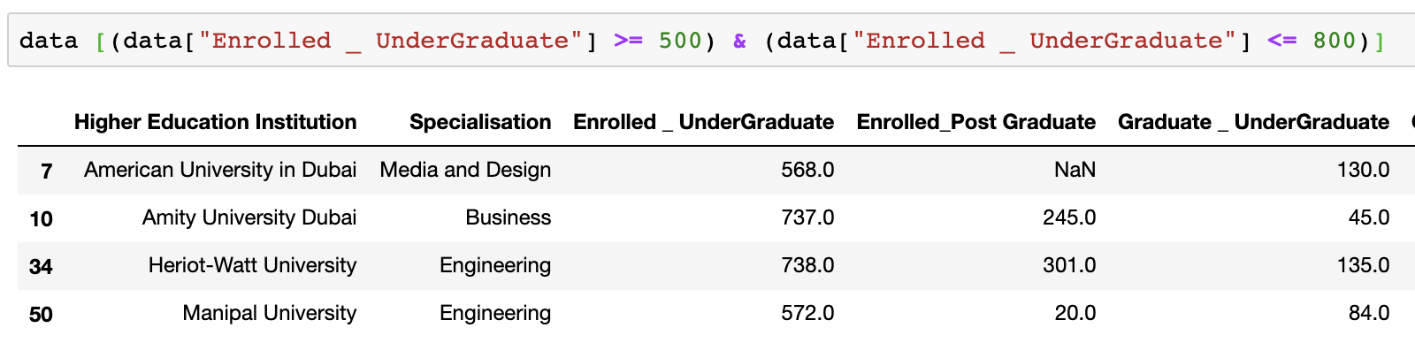
Slice data using multiple conditions
Example 2
Display all the rows where "Enrolled _ UnderGraduate" value is from 500 to 800
Condition
(data["Enrolled _ UnderGraduate"] >= 500) & (data["Enrolled _ UnderGraduate"] <= 800)

Slide 9
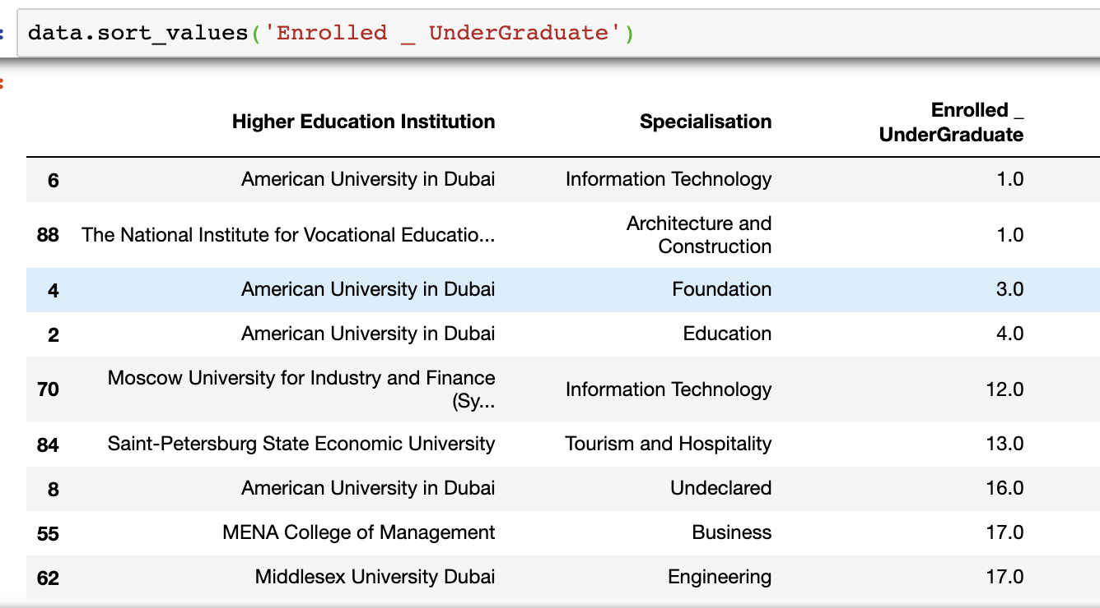
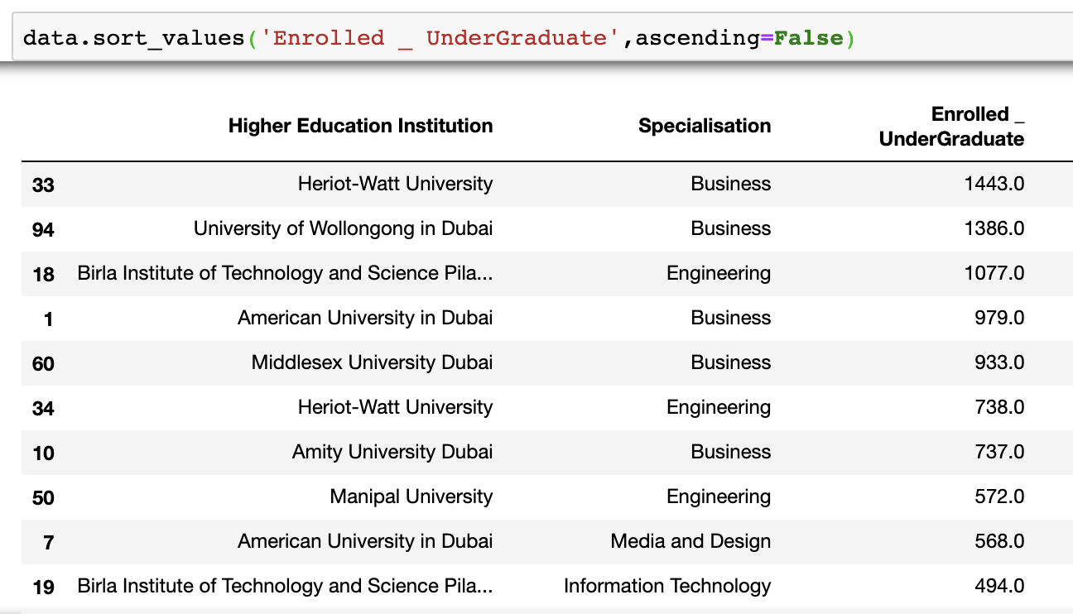
Sorting data with one column
Sorting data is a technique that display data in an ascending or descending order.
Syntax
By default, the data will be sorted in ascending order.
Example:
Sort the Enrolled _ UnderGraduate column
Ascending Order
Descending Order

Slide 10
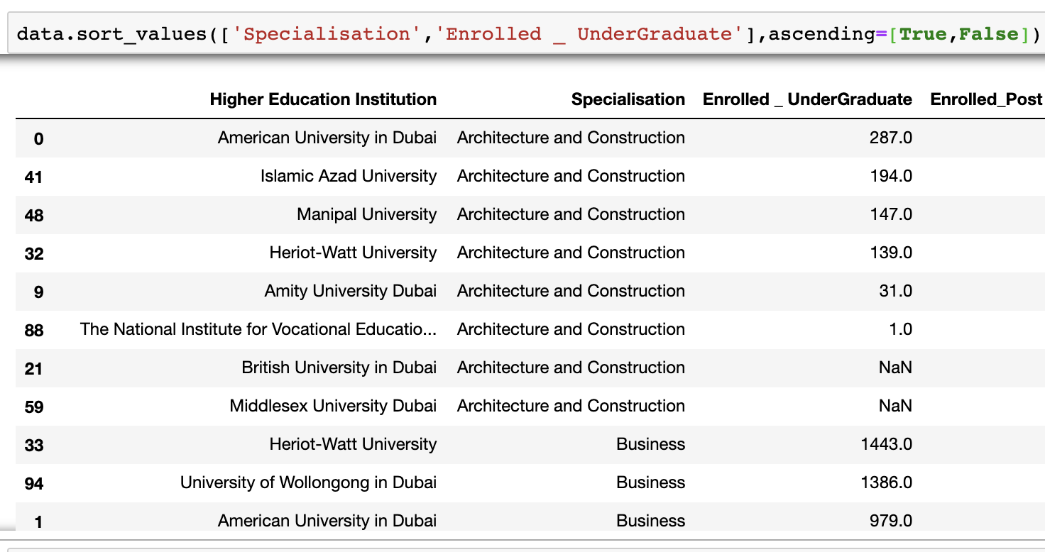
Sorting data with more than one column
To sort data based on more than one column, you need to include all columns inside the square bracket.
Example:
Sort Specialisation in ascending order, Enrolled undergraduate in descending order

Slide 11
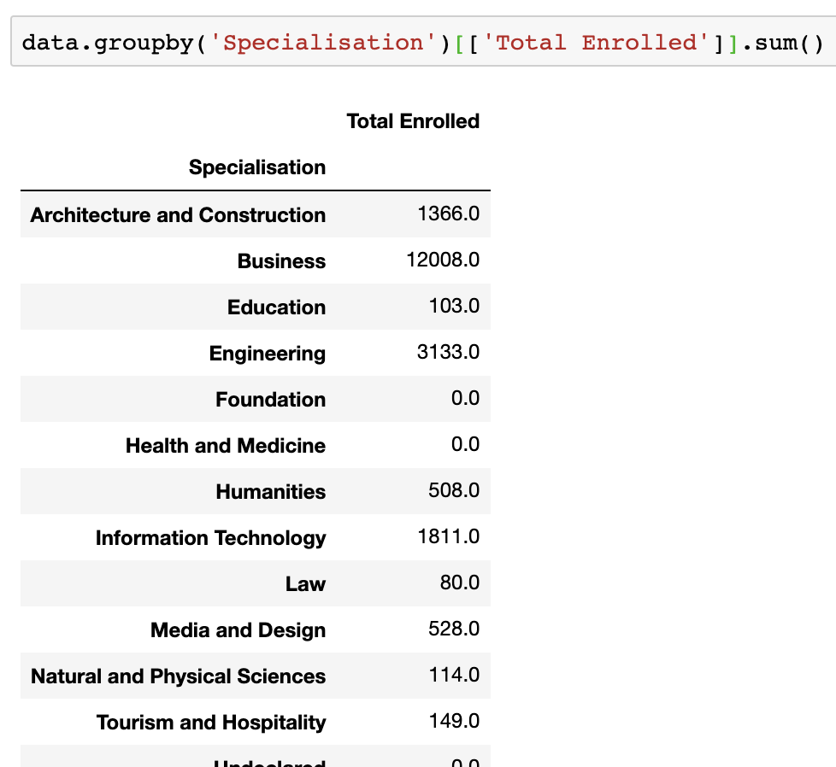
Grouping Data
Grouping data by columns is used when you have duplicated data in a particular column. For example you, the same student is doing more than one course and has grades in each course. The function needed for this operation is .groupby.
Syntax
Instead of mean(), you can use sum(), min() or any of the aggregation commands.
Example:
Total. Number of students enrolled in each specialisation

Slide 12
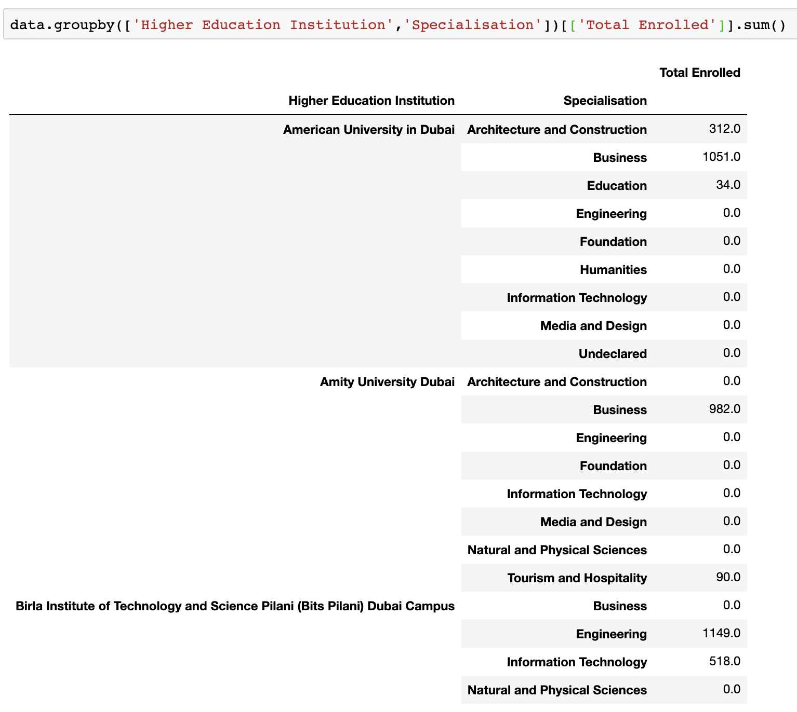
Grouping Data
Example:
Total. Number of students enrolled in each specialisation, by each Institution

